Slide 1
Comprehensive Market Analysis of US Fast Food Restaurants
Shibbir ahmed arif
MS – Data Science
Montclair state university

Slide 2
Report Outline
Objective
Data Collection
Data Load
Data Exploration
Data Cleaning
Data Analysis
Map Visualization
Aggregation Visualization
Interactive Visualization
Conclusion

Slide 3
Objective
Choosing the fast food industry for market analysis.
Focusing on the distribution of fast food restaurants across various states in the USA.
Aiming to study the openness of the market for potential opportunities.
Analyzing the potential benefits for new fast food stores entering the market.
Identifying possible locations for new fast food restaurants based on the analysis.
Considering the dataset to be representative of the broader fast food market.

Slide 4
Data Collection
This is a dataset of 10,000 fast food restaurants provided by Business Database of Datafiniti.
The dataset includes the restaurant's address, city, latitude and longitude coordinates,
name, and more.
Data is collected from 2014 to 2019.
Data Source: https://data.world/datafiniti/fast-food-restaurants-across-America

Slide 5
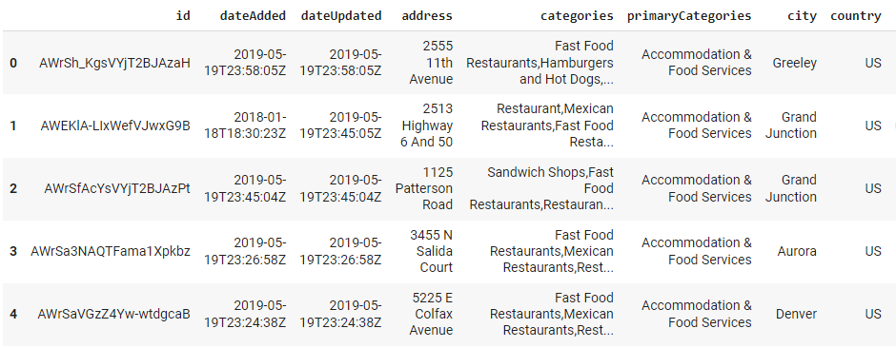
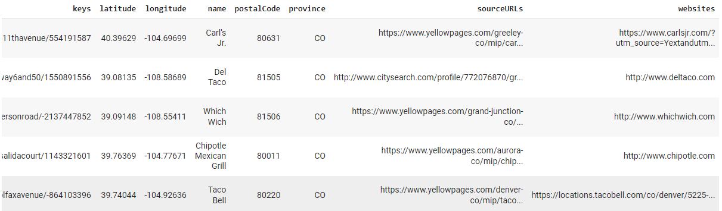
Data Load

Slide 6
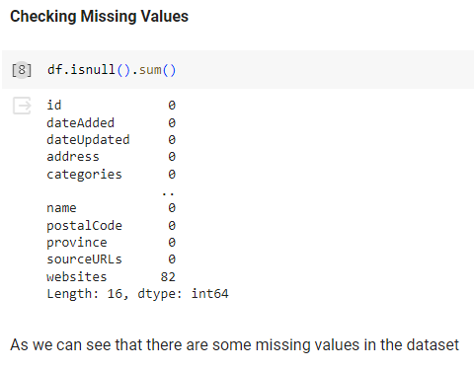

Data Exploration
Data Shape – (10000, 16)

Slide 7
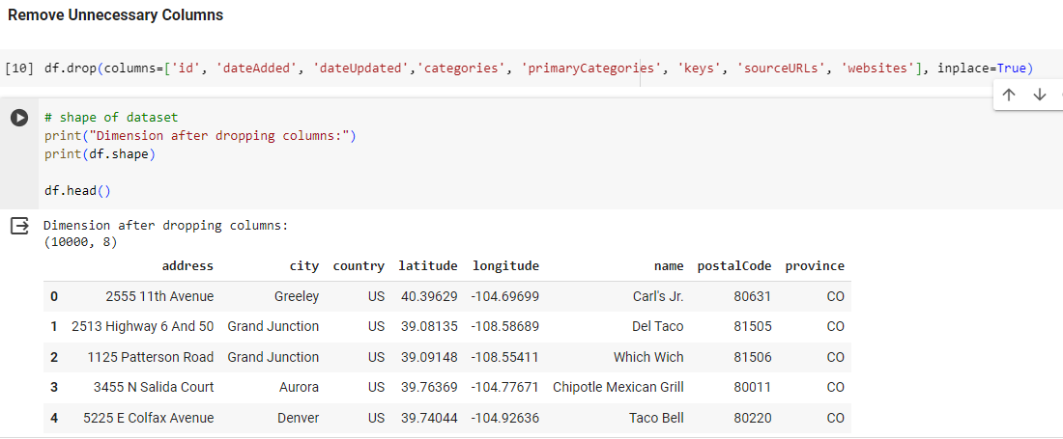
Data Cleaning

Slide 8
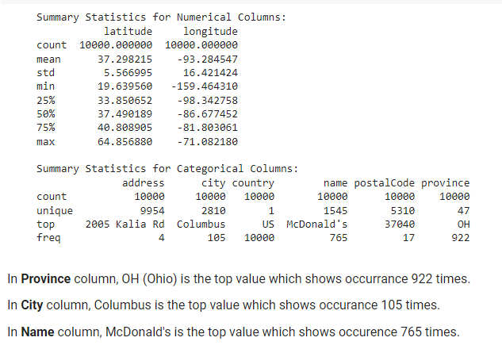
Summary Statistics

Slide 9
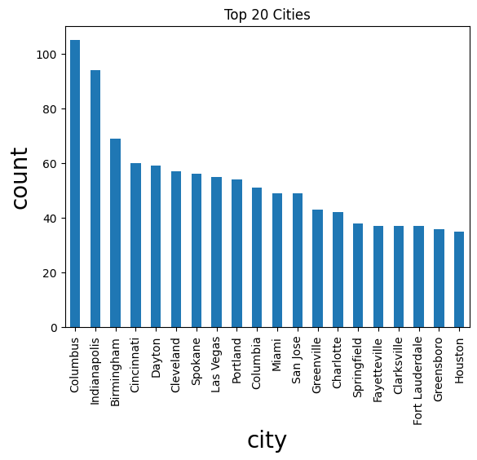
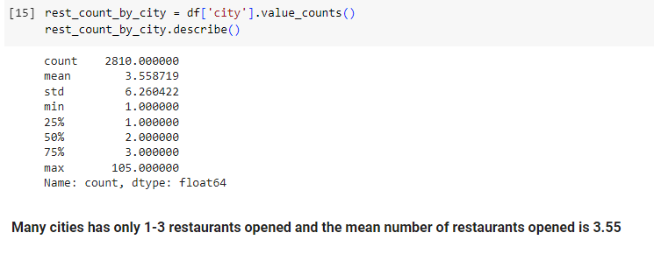
Data Analysis

Slide 10
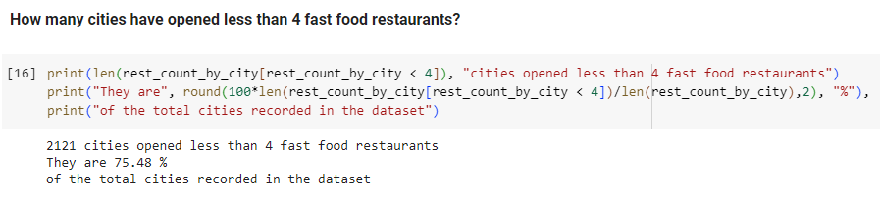
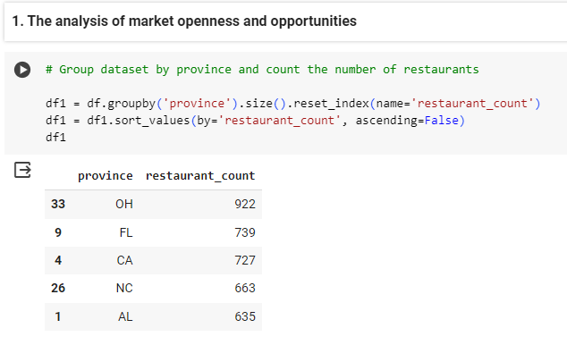
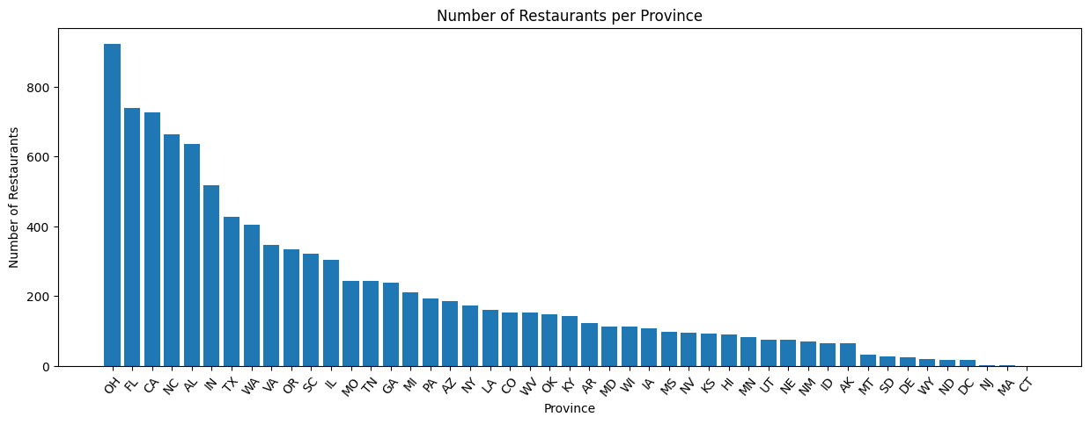
Data Analysis – Cont.

Slide 11
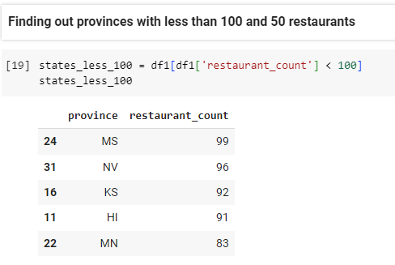
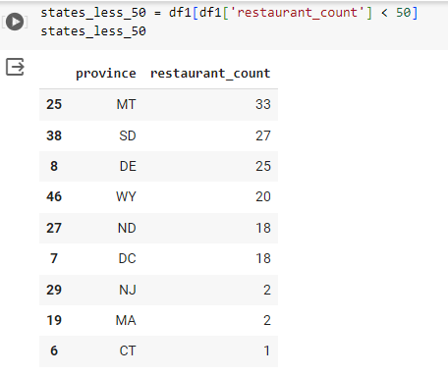
Interactive Map Visualization 1

Slide 12
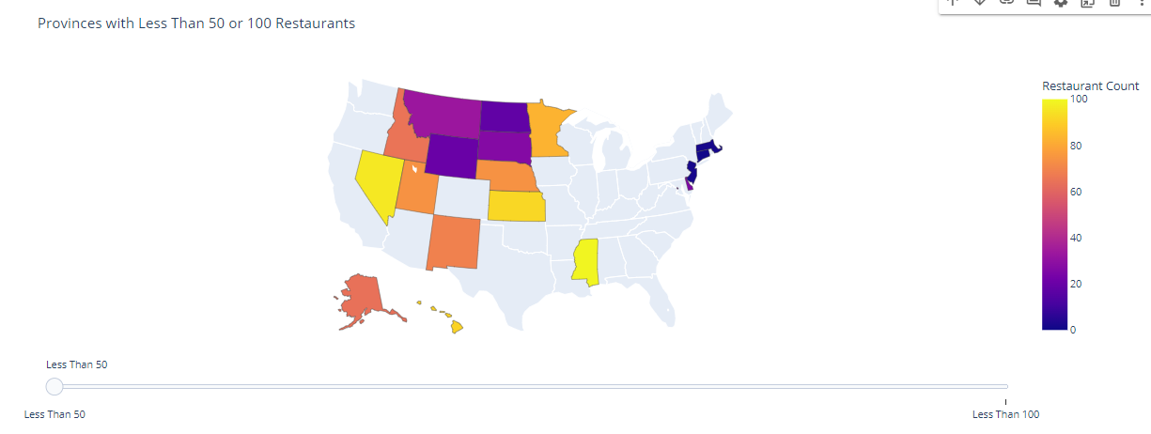
Map 1

Slide 13
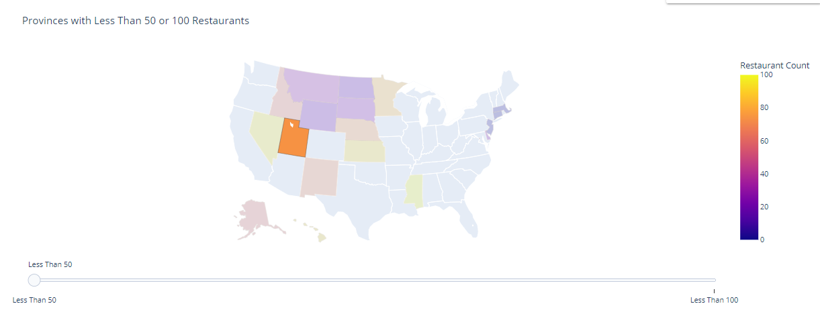
Map 1
Observation: Select the above areas where the amount of stores is less than 50 or 100 for the development of new fast food stores, having a large relatively unopened market and being given more opportunities, reducing competition with strong competitors in bustling areas.

Slide 14
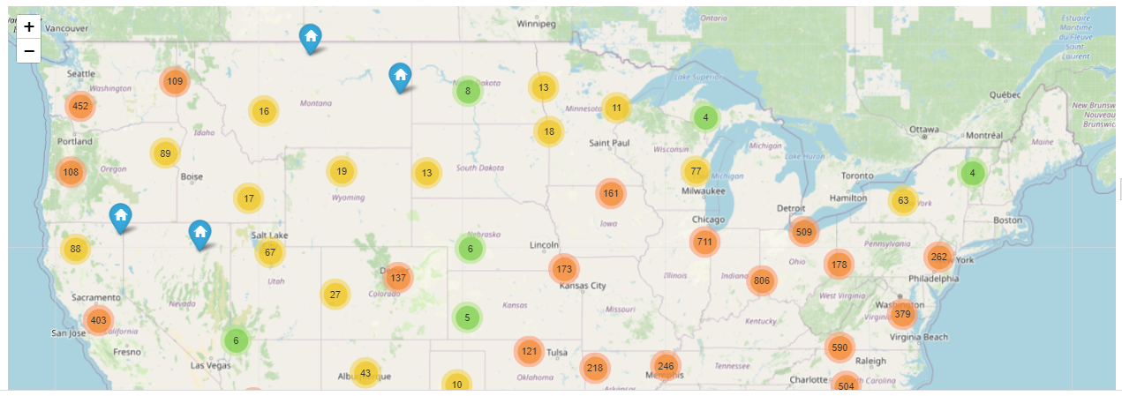
Interactive Map Visualization 2
I see presence across all the states with Georgia, Indiana and Florida leading the way.

Slide 15
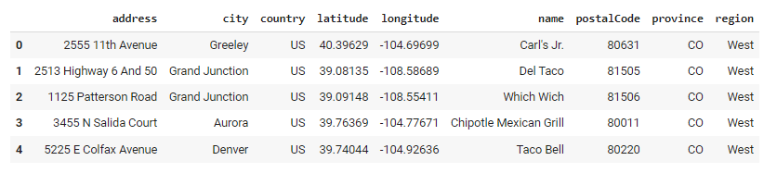
Continue
Now lets split the entire market into 4 key regions

Slide 16
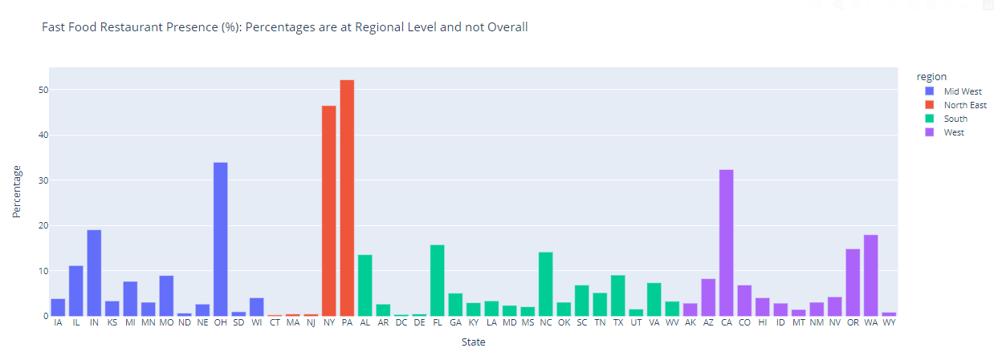
Interactive Aggregation Visualization 1

Slide 17
Continue
Observation
In the West, California accounts for 32.4% of the total number of restaurants, and Washington and Oregon are still a long way off, accounting for about 18% and 14.9% respectively.
Florida (15.8%) and North Carolina (14.2%) are the top two markets in the South, while Pennsylvania (52.2%) and New York (46.5%) lead the Northeast.
In the Midwest, Ohio has the highest at about 34%.

Slide 18
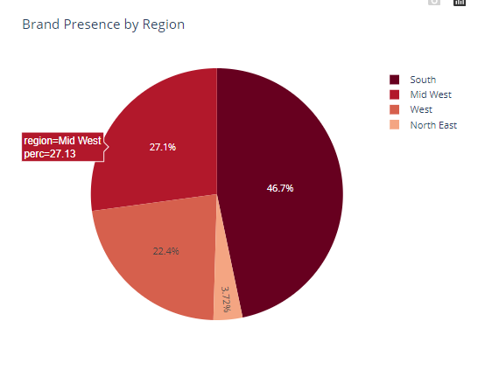
Interactive Aggregation Visualization 2

Slide 19
Continue
Observation
With 46.7% of fast food restaurants located at South takes the top spot while North East contains only 3.72%.
For Brands looking to enter the market or expand their footprint, South and Mid West are favorable.

Slide 20
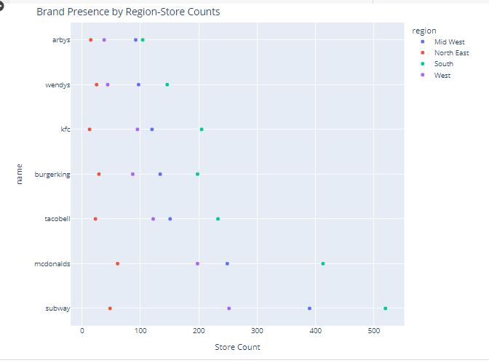
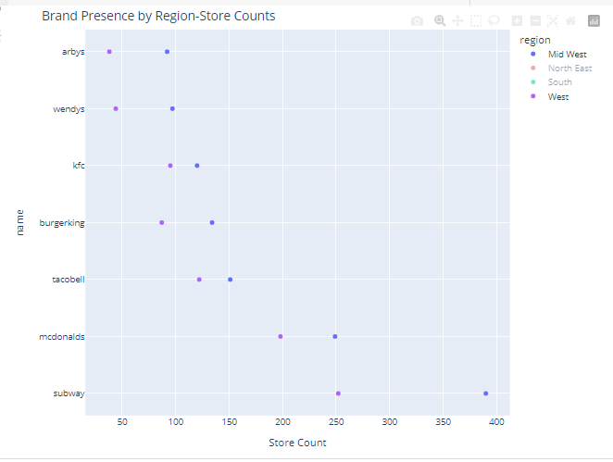
Interactive Aggregation Visualization 3

Slide 21
Continue
Observation
Subway, McDonalds, Taco Bell, KFC, Burger King, Wendys and Arbys are the most popular Brands. Clearly all the Brands have big presence in South followed by Mid West.

Slide 22
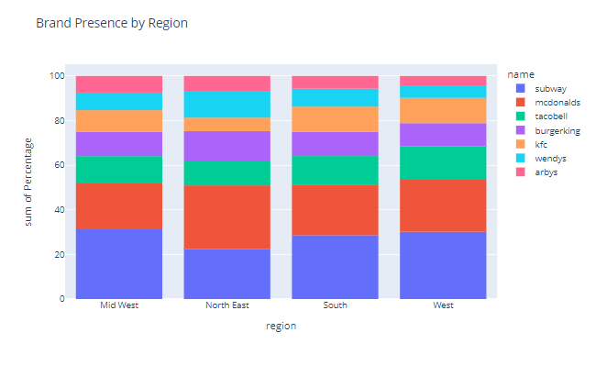
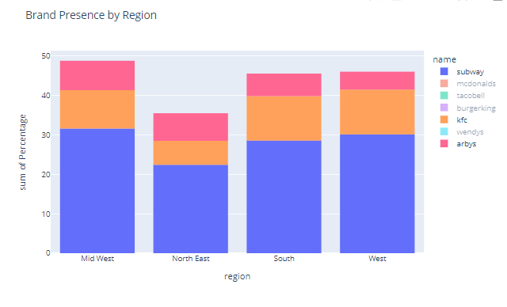
Brand Presence by Region

Slide 23
Continue
Observation
Subway market penetration is above 28% in Mid West, South and West regions with highest of 31.6% in Mid West
Burger King has higher penetration in North East after McDonalds and Subway.
Taco Bell has concentrated more in West
Arbys has least presence in West

Slide 24
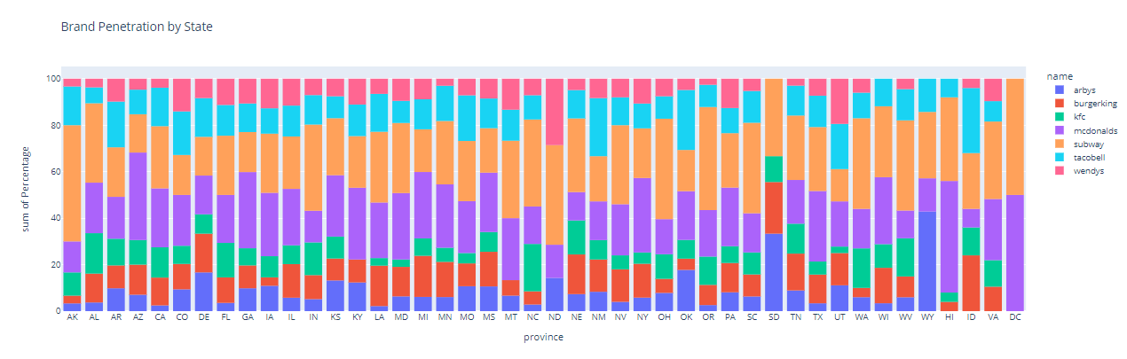
Interactive Aggregation Visualization 4

Slide 25
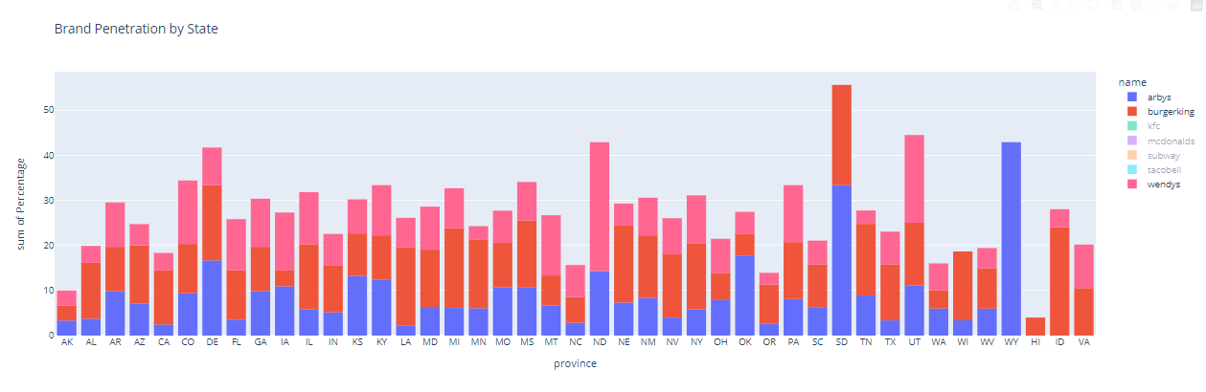
Continue

Slide 26
Continue
Observation
Analyzing by state I learn the top markets for each brand. I observe that they are present in most of the markets.
In Washington, D.C. only 2 brands are present
For McDonalds, Washington, D.C., Hawaii and Arizona are key markets.
Wendys is present in all states except Wisconsin, South Dakota, Wyoming and Hawaii
For Arbys, Wyoming and South Dakota are the key ones.
KFC is absent in 4 states. They are - Kentucky, Montana, North Dakota and Wyoming

Slide 27
Conclusion
Market Landscape
Most of the fast food restaurants are located in South and Mid West. Further in each of the four regions few states have higher market share than others by large margin.
At National level, Ohio, Florida, California, North Carolina and Alabama are top states attracting most of the businesses

Slide 28
Continue
Brand Presence
Top Brands have presence in almost all geographies with Subway having more stores than others by a considerable margin.
This tells us that key growth strategy for Brands has been "Market Development" i.e. offer products/services in newer markets as a way to grow revenues Subway share is above 28% in all regions followed by McDonald's at 20-28%.
Given the ubiquitous presence of brands, there is intense stiff competition in market. This creates added pressure on Brands to differentiate their product offerings
In market characterized by high volume-low margin transactions mere survival may not be best long term strategy

Slide 29
Thank You!

